Slide 1

Supro
Final Presentation by: Brian Hoang
& Chris Villegas

Slide 2

Outline
Introduction: What is Supro?
Early Development / Initial Research
Building and Testing
New Features
Refactor
Conclusion
Acknowledgements
May 23, 2017

Slide 3
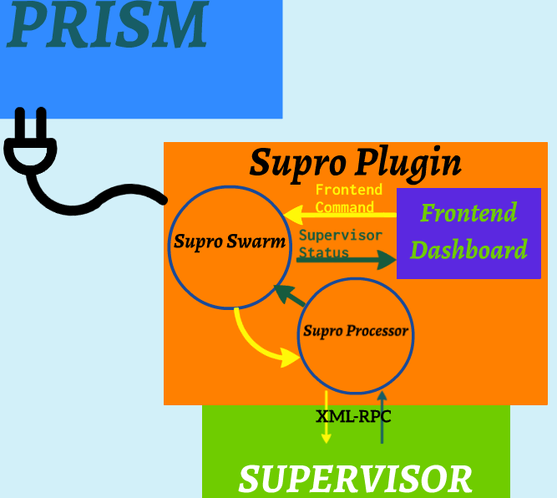
Introduction to Supro
Prism - a software developed at JPL that allows for visualization software to connect to autonomous boats.
Supervisor - an open source process management software.
Supro - a Prism-plugin;
real-time Supervisor dashboard.
May 23, 2017

Slide 4
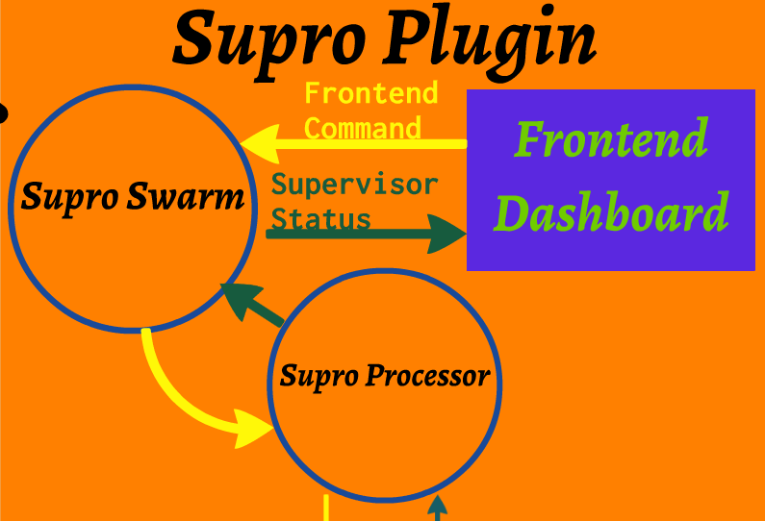
Supro Plugin
Communicates with Supervisor via XML-RPC
Monitors process status and reports it to frontend
Executes commands from the frontend on processors running Supervisor
May 23, 2017

Slide 5
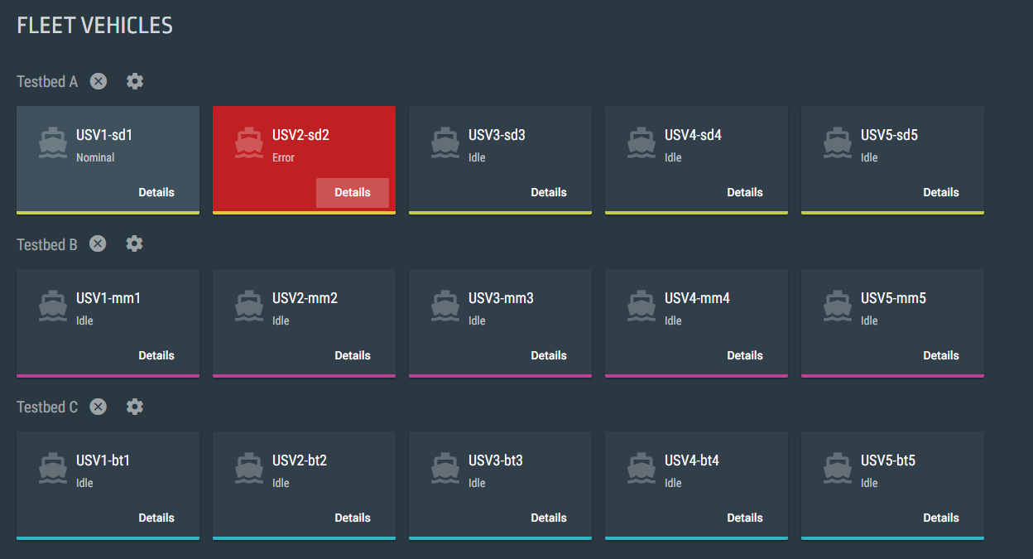
Supro is used for monitoring and managing processes running across an autonomous fleet.
May 23, 2017
￼

Slide 6
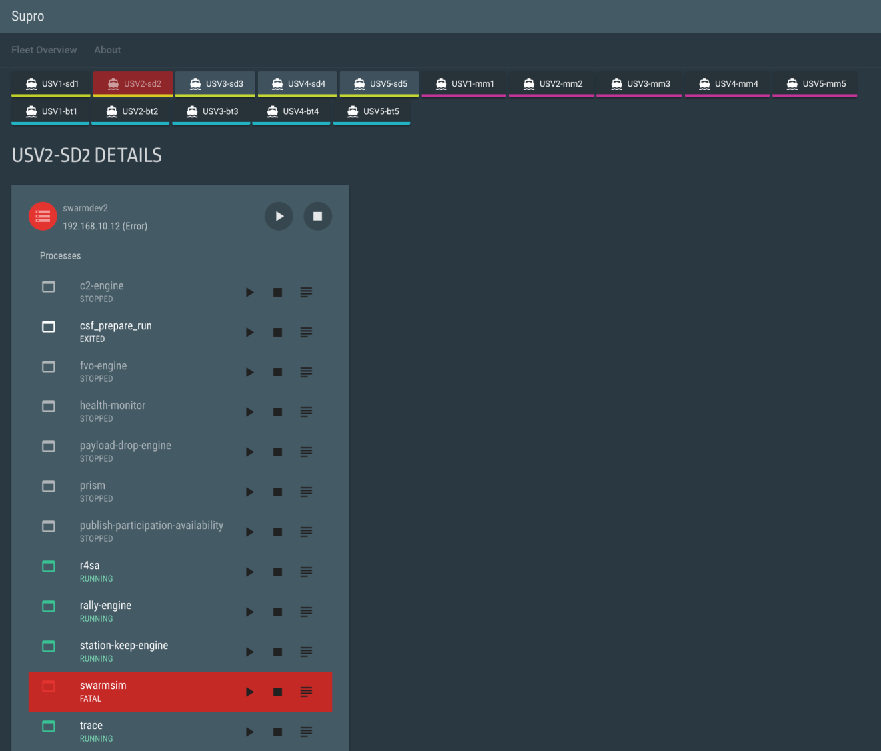
Supro allows the user the ability to track and control multiple processors running supervisor.
Multiple processors may exist within a single vehicle
Multiple vehicles may exist in a testbed
May 23, 2017
￼

Slide 7

Supro Detail View
The detail view shows all processes managed by an instance of Supervisor on a single CPU.
May 23, 2017
￼

Slide 8
Supro Detail View
Each process shows its state.
Process States:
RUNNING
STOPPED
BACKOFF
FATAL
May 23, 2017
￼

Slide 9
Supro Detail View
Users may start and stop processes and can also pull up a processes Tail-log.
May 23, 2017
￼

Slide 10
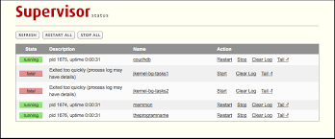
Why did we develop Supro?
Supervisor has a dashboard already but it is limited to displaying one instance of supervisor per web browser window.
May 23, 2017
￼

Slide 11
Why did we develop Supro?
We wanted to have multiple instances of Supervisor displayed in one dashboard.
May 23, 2017
￼

Slide 12
Objectives
Help with Navy testing and research of autonomous boats
Create an intuitive user interface where testers can easily manage Supervisor processes
Design our module so that our code can easily be used for other projects
May 23, 2017

Slide 13
Our approach
Python - Object oriented language used for Supro backend
Angular - JavaScript framework used for Supro frontend
May 23, 2017

Slide 14
Early Development / Initial Research
Supervisor
WebSockets
Multithreaded Programming
Queues
JSON
May 23, 2017

Slide 15
Supervisor
Supervisor is an open-source process management software that runs as a daemon.
Maritime robotics is using Supervisor to manage processes running on autonomous boats.
Supervisor has an API.
Supervisor has a UI but it was not suited for our testing purposes
￼

Slide 16
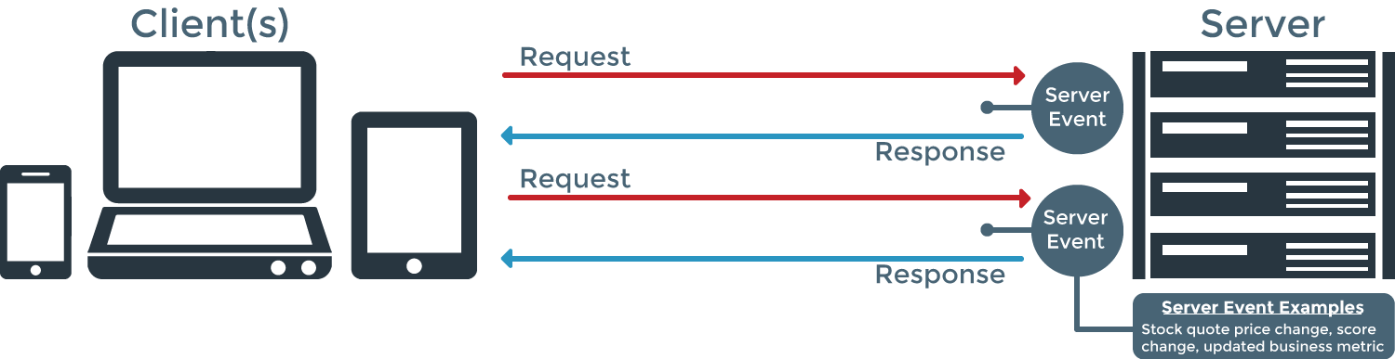
Supro WebSocket
Server Event Example
Start/Stop Process
May 23, 2017

Slide 17

SockJS
SockJS-tornado is a Python server for WebSocket emulation.
Callbacks:
on_open – Starts a new session with a web client and swarm_model is sent to the UI.
on_message – Receives a message from the UI and adds it to a queue to send to the backend.
on_close – Ends a session with a web client.
* Swarm_model - a description of the swarm in JSON. Reflects the testbed, boat, and processor structure.
May 23, 2017

Slide 18
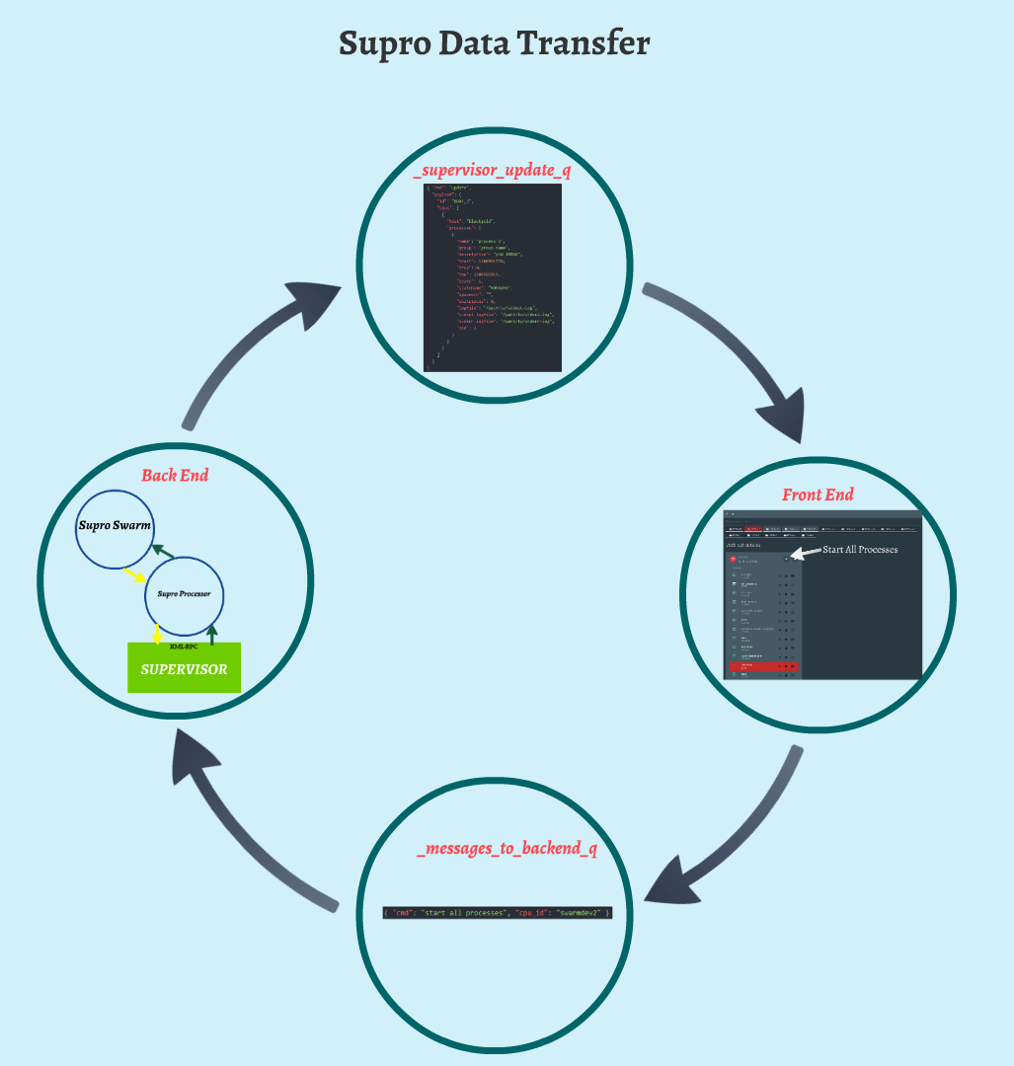
Supro Data Transfer
May 23, 2017

Slide 19
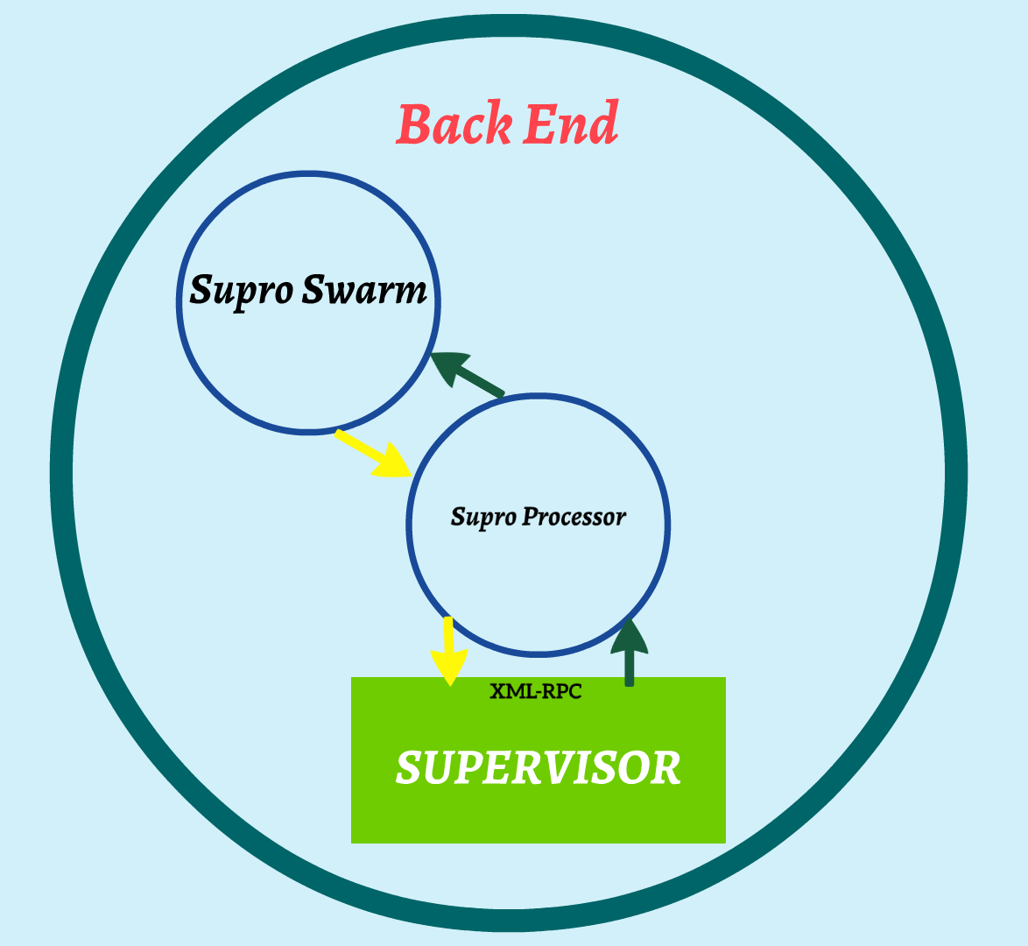
Supro Back End
May 23, 2017

Slide 20
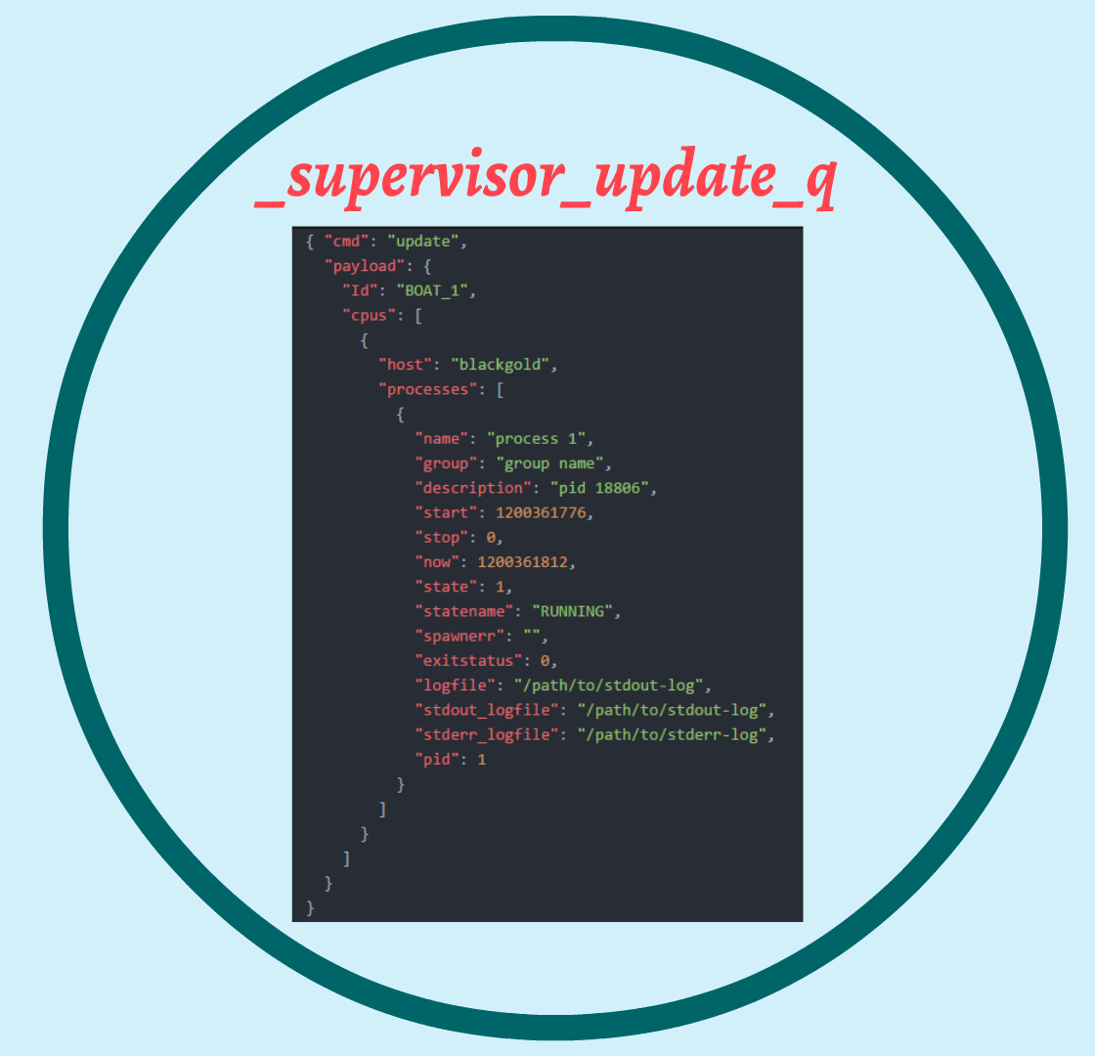
_supervisor_update_q
May 23, 2017

Slide 21
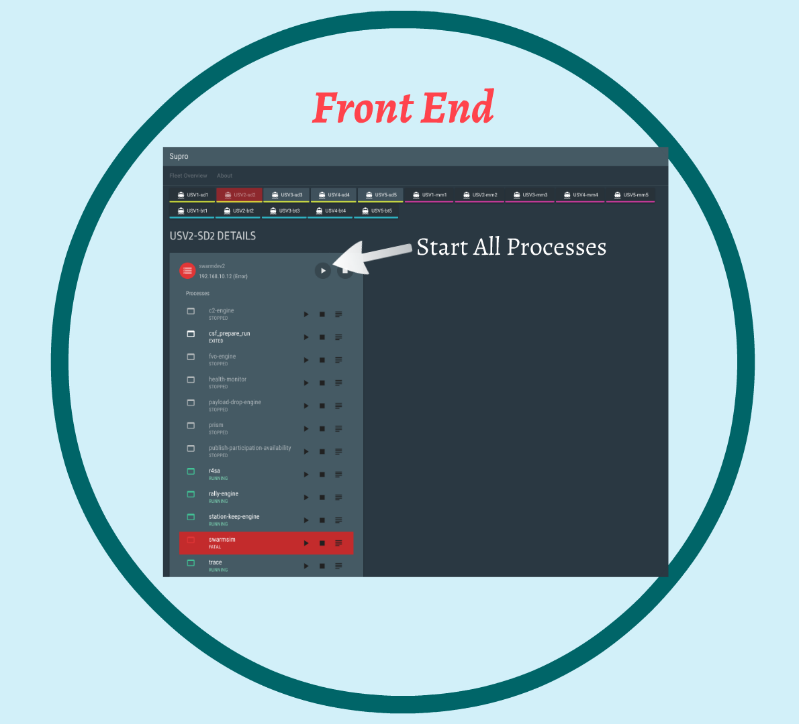
Supro Front End
May 23, 2017

Slide 22
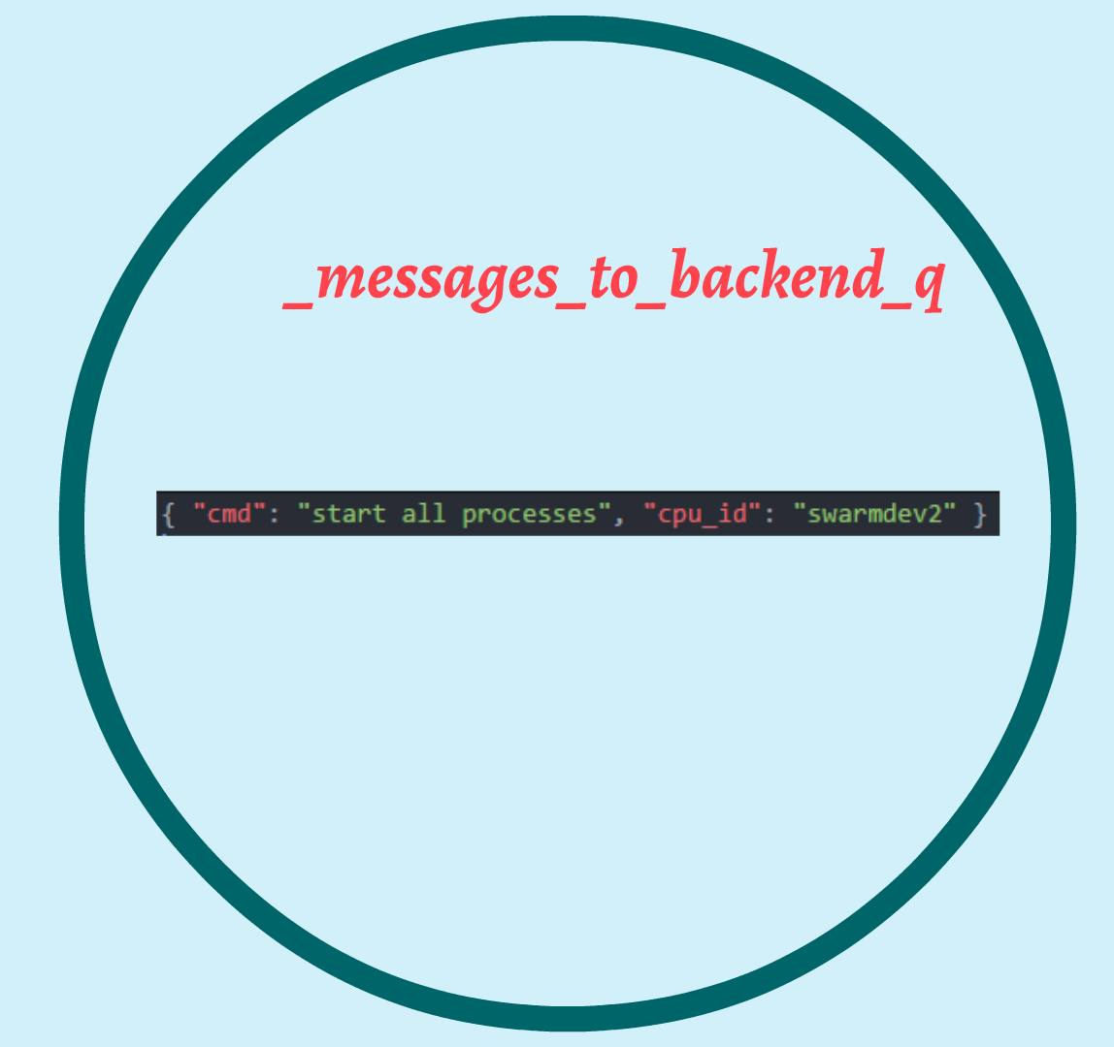
_messages_to_backend_q
May 23, 2017

Slide 23
Supro Multithreading
Supro classes that implement threading module:
SuproProcessor – maintains a connection between supervisor on a single machine and Supro.
Connect to supervisor if connection has not yet been made or is lost
Send supervisor status updates to the UI
Report a loss of connection to the UI if unable to reach supervisor
SuproSwarm – creates and manages all ‘swarm entities’.
Get next message from UI and process its command
See if any processor threads have crashed and restart them if they have
Execute command on appropriate swarm entity
Broadcast swarm status updates
May 23, 2017

Slide 24
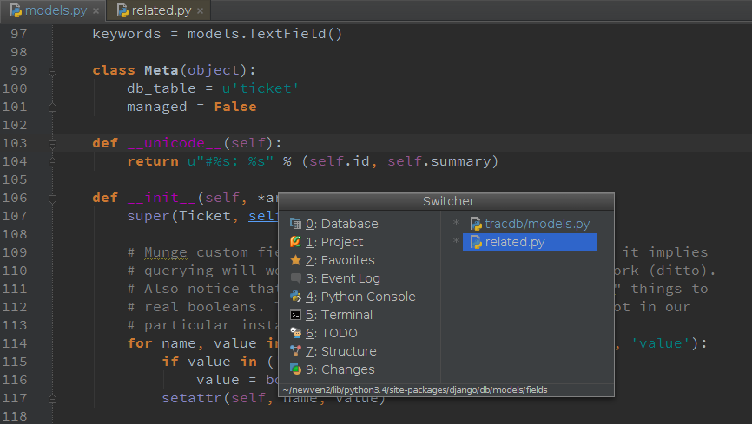
Building and Testing
First version of the backend (WebSocket Class)
Incorporating the front end
Building RPMs
May 23, 2017

Slide 25
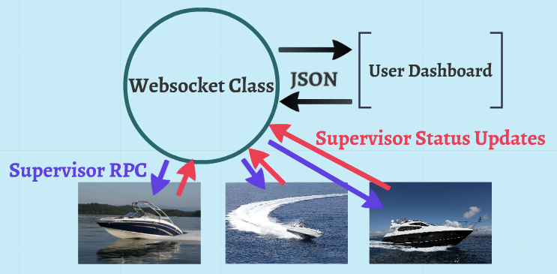
First WebSocket Class
May 23, 2017

Slide 26
Incorporating the Front-end
When a new web session is opened, the UI needs a swarm model to render a dashboard for each boat in the swarm.
Messages coming from the UI could be different types of commands. These each needed to be parsed and executed correctly by the backend.
May 23, 2017

Slide 27

Building RPMs
Once our first version was tested, we created an RPM and released it for use.
RPM stands for "Redhat Package Manager"
Easy way to install and update programs on Linux
Once a new feature is tested, we build and release a new RPM
May 23, 2017

Slide 28

New Features
Stop/Start/Restart All Buttons
Logging
Testbed Support
Exception Handling
May 23, 2017

Slide 29
Stop/Start/Restart All
Implemented functions to stop, start, and restart all processes specified in the config file.
Buttons were added on the UI to send commands for backend to call the appropriate supervisor XML-RPC methods.
startAllProcesses(wait=True)
stopAllProcesses(wait=True)
wait – Boolean: waits for each process to be fully started or stopped.
Restarting all processes is a combination of the two.
May 23, 2017

Slide 30
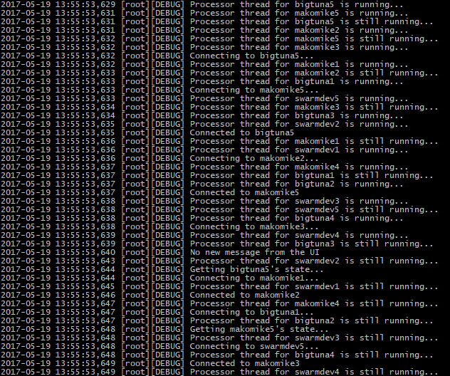
Supro Logging
Log records formatted to include date/time, user, and level name along with the message.
Log records stored into a file called “output.log”
Errors are stored into a file called “error.log”
Debug level log records used to let us know if messages are being sent, opening and closing of connections, and if threads are still running.
Error/Exception level log records let us know if commands aren’t working correctly and if threads crashed.
May 23, 2017

Slide 31
Testbeds
Implemented support for multiple testbeds of boats.
Reformatted messages being sent to the front end to include an extra layer for testbeds.
UI updated to support multiple testbeds
Testbeds separated by name
All vehicles within a testbed have a matching color.
Buttons to start/stop/restart all processes within a testbed.
May 23, 2017

Slide 32
Testbeds
May 23, 2017

Slide 33
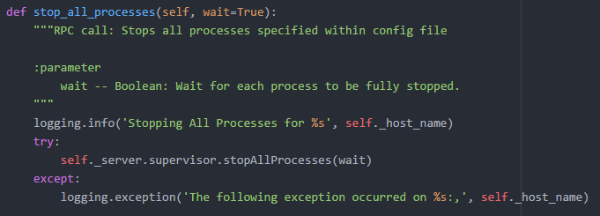
Supro Exception Handling
May 23, 2017

Slide 34

Refactor
Too many new features
Poor ad hoc approach
Unclear function/variable/class names
Inconsistent naming conventions
Redundant imports
Deprecated components
May 23, 2017

Slide 35
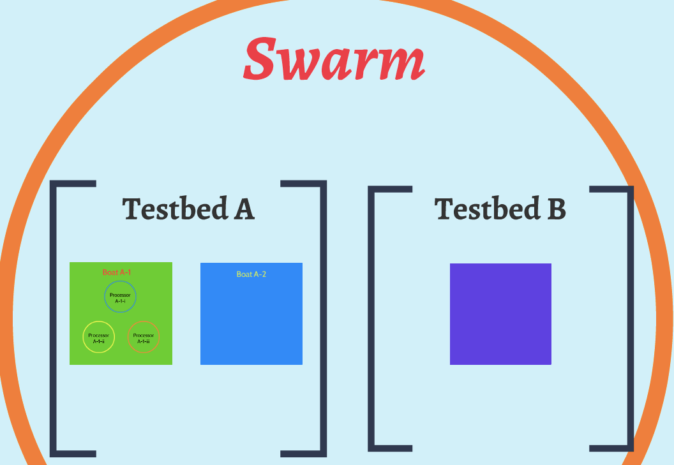
Hierarchical Structure
Changing the backend to be structured in a Hierarchy helped us solve some of our issues.
Swarm
V
Testbed
V
Boat
V
Processor
May 23, 2017

Slide 36
Hierarchical Structure
Swarm module manages all other swarm entities. It executes commands on any level of the swarm
Swarm
V
Testbed
V
Boat
V
Processor
May 23, 2017
￼

Slide 37
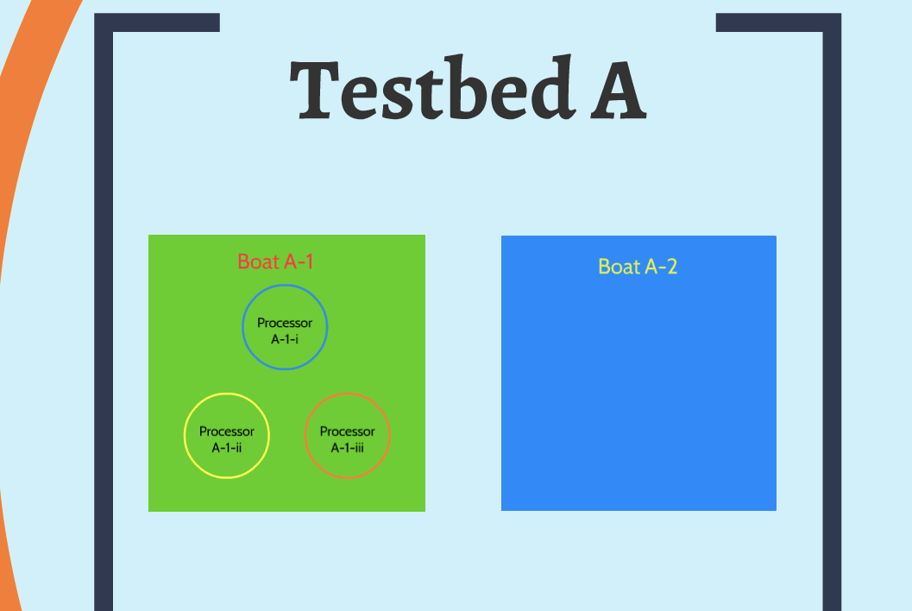
Hierarchical Structure
Testbed module manages a series of vehicle (boats) entities. It can execute commands on all of its boats.
Swarm
V
Testbed
V
Boat
V
Processor
May 23, 2017

Slide 38
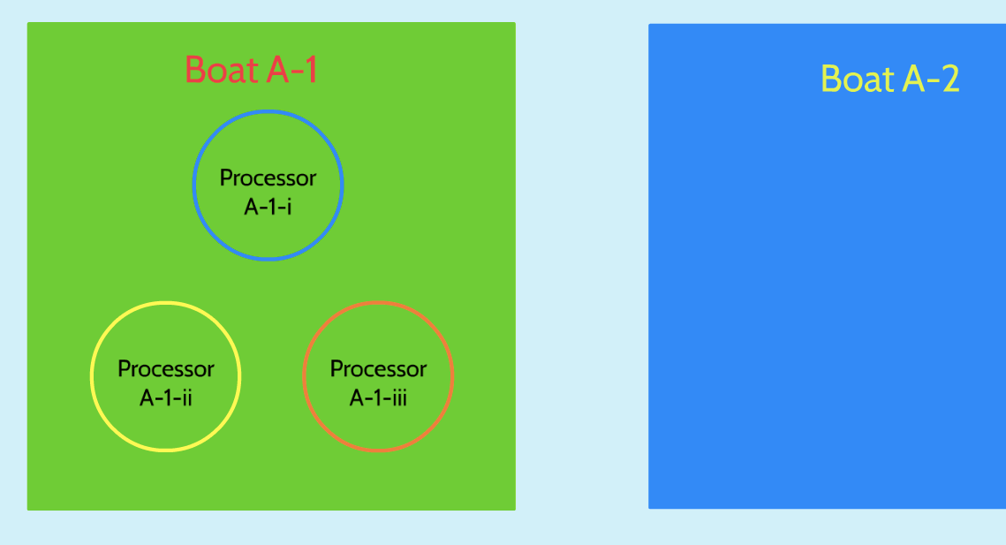
Hierarchical Structure
Boat module manages a series of Processor entities. It can execute commands on all of its processors.
Swarm
V
Testbed
V
Boat
V
Processor
May 23, 2017
￼

Slide 39
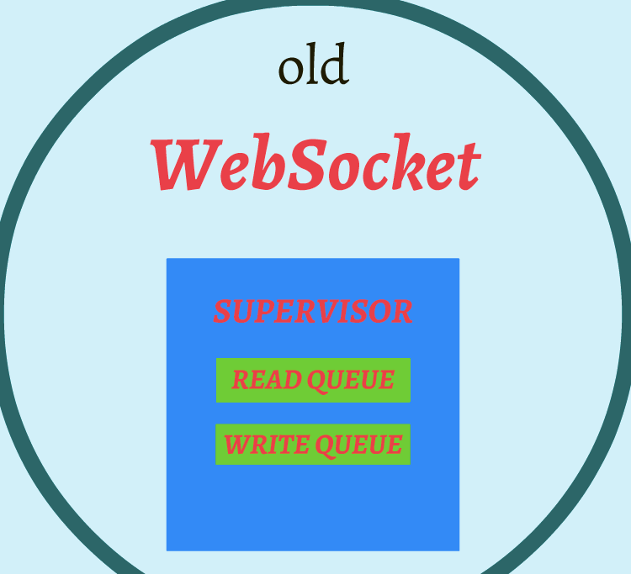
Changing the web_socket class
Old
Our first version of a WebSocket class managed 2 message queues for each instance of supervisor.
May 23, 2017

Slide 40
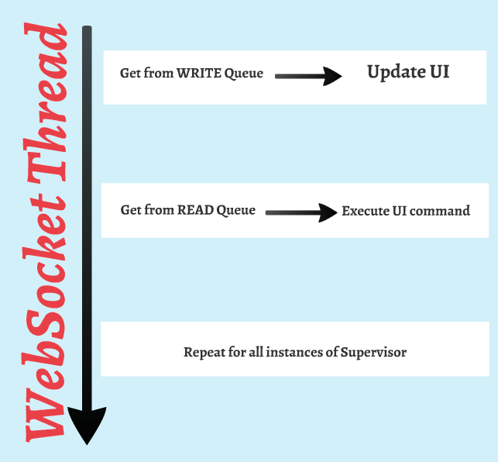
Changing the web_socket class
Old
This class also ran its own thread, relaying messages and commands between the front and back ends.
May 23, 2017
￼

Slide 41
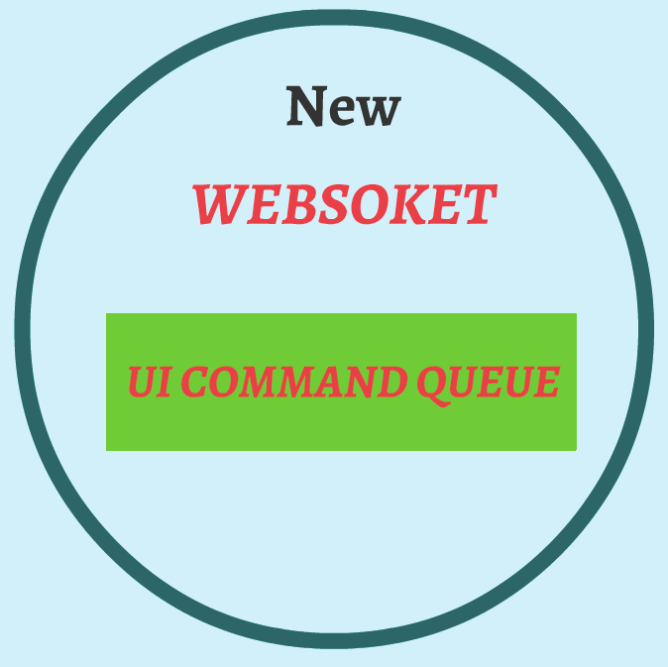
Changing the web_socket class
New
Only puts messages from the UI into messages_to_backend_q whenever a new command is sent
Much simpler
May 23, 2017
￼

Slide 42
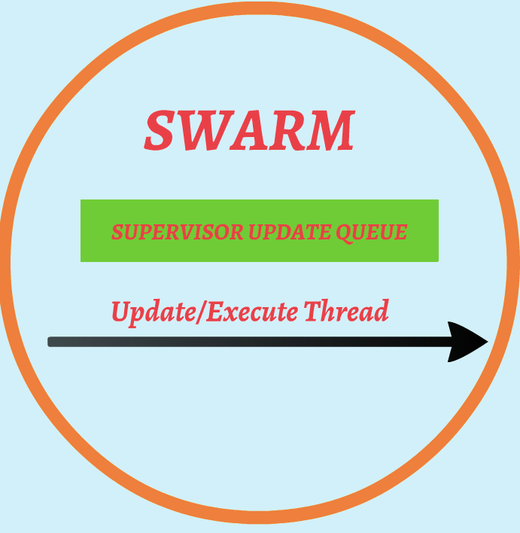
Changing the web_socket class
New
Thread to update the UI with Supervisor status and execute commands from the frontend now belongs to Swarm class.
May 23, 2017

Slide 43
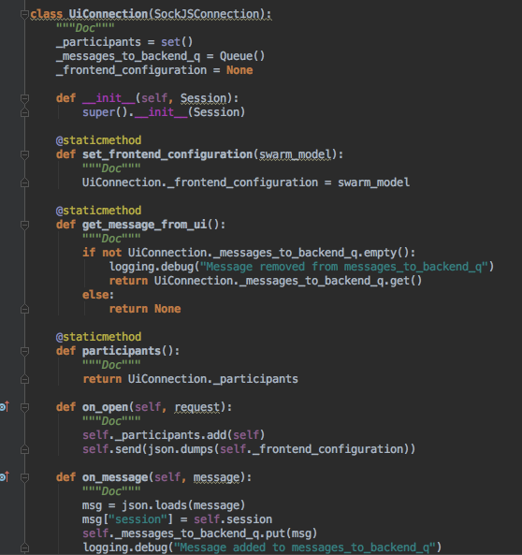
Cleaning up the code
Clear and concise names
Neat and short functions
Consistency
Generality
Function Table (instead of if-else)
May 23, 2017

Slide 44
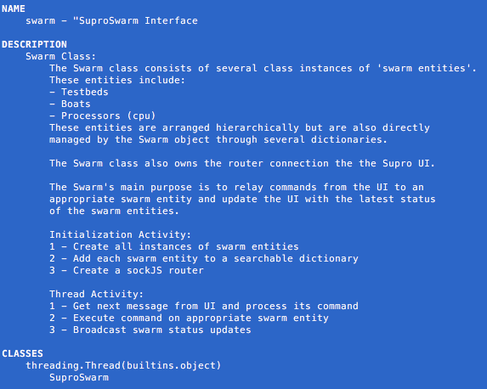
Documentation
Pylint
Docstring
Pydoc
May 23, 2017

Slide 45
Conclusion
May 23, 2017

Slide 46
Things we learned
Multithreaded Programming
JSON
WebSockets
Logging
The importance of source control
Linux Commands
May 23, 2017

Slide 47
Challenges we faced
Not having root access
Constant debugging
Difficulty having things installed
New concepts
May 23, 2017

Slide 48
Final Thoughts
Interning at JPL was:
Amazing
Inspiring
A tremendous learning experience
A great place to hone our skills
Humbling
Hard work
Very fun
May 23, 2017

Slide 49
Acknowledgements
Special thanks to:
Marc Pomerantz - SIRI Mentor
Calvin Huang - Supro Developer
Michael Sandoval - Maritime Robotics
Michael Wolf - Maritime Robotics
William Adler - IT
Roslyn Soto - SIRI Coordinator
Eddie Gonzales - Education Office
Jessica Parker - Education Office
Daisy Sang - Faculty Advisor
And all the wonderful people at JPL. You are all awesome!
May 23, 2017

